Slide 1


Inventory Accuracy
February 2025
Jim Daum, Implementation Specialist

Slide 2
Agenda
1.
Stocking Levels
2.
Inventory Valuation Report
3.
Where To Set Stocking Levels
4.
Using History To Set Levels

Slide 3

Inventory is Money
This Photo by Unknown Author is licensed under CC BY-NC

Slide 4
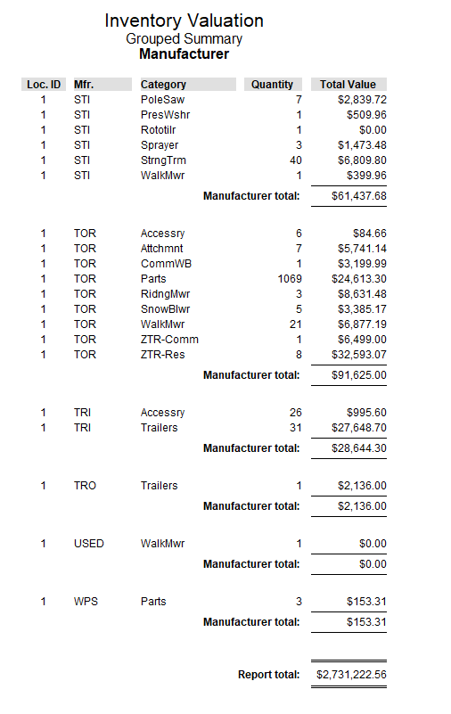
Do you know your $$$?

Slide 5
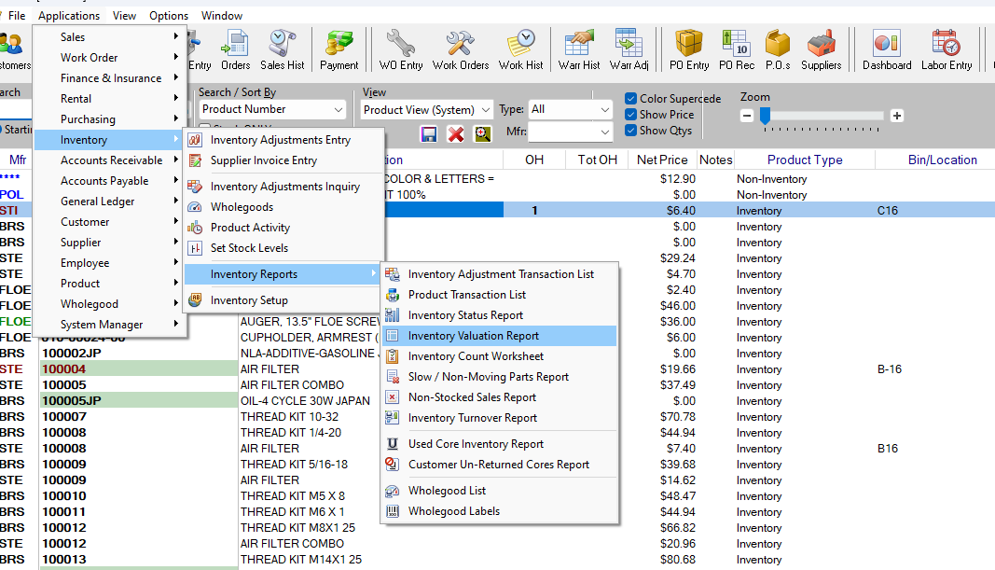
Inventory Valuation Report

Slide 6
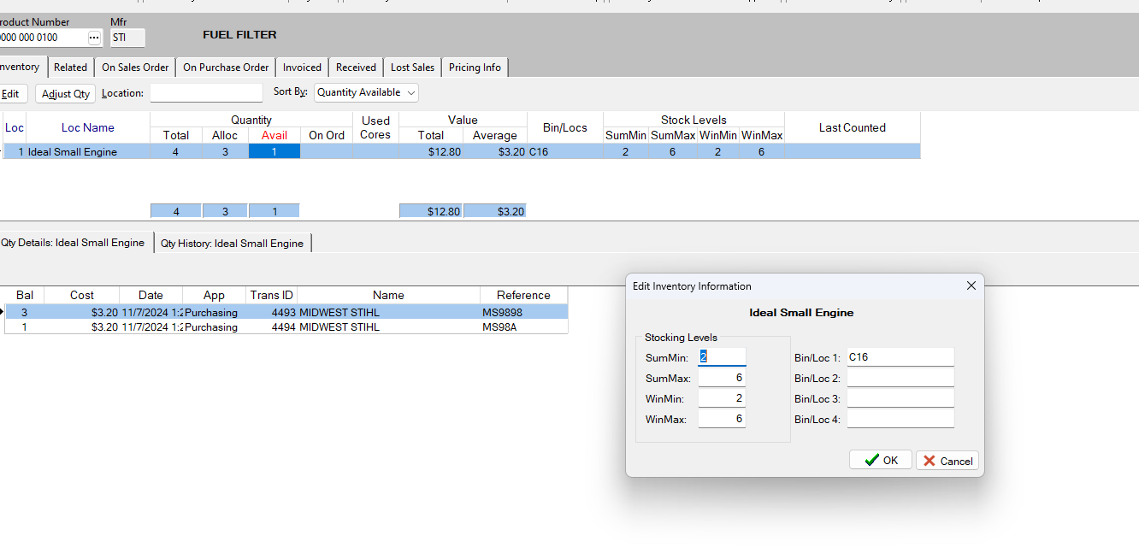
Product Stock Levels

Slide 7
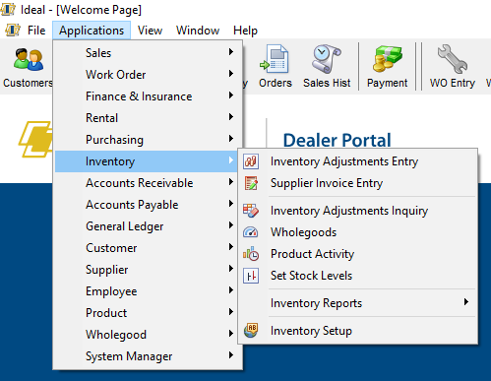
Setting Stocking Levels

Slide 8
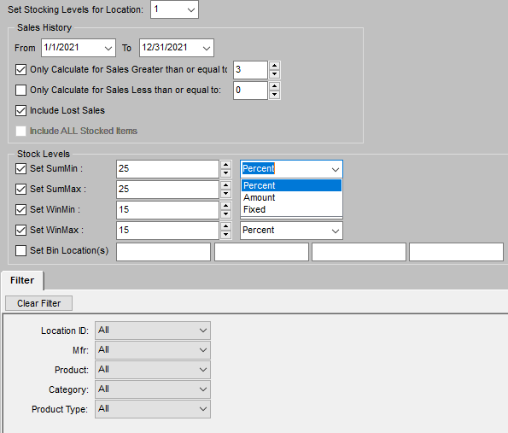
Stocking Level Settings

Slide 9
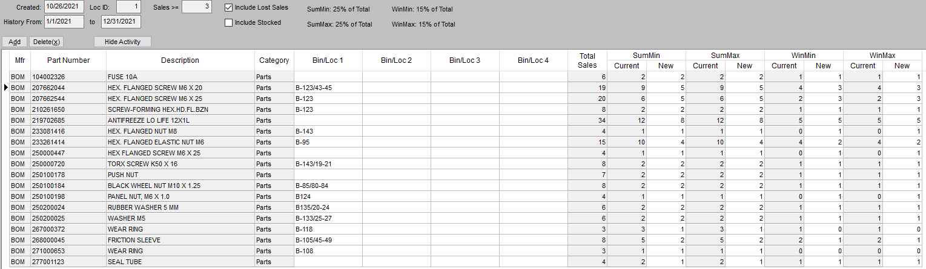
Automates All Products From History

Slide 10
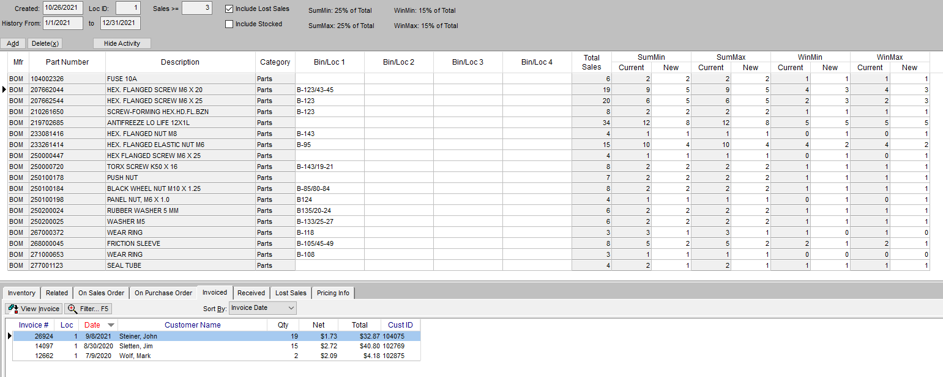
Min / Max Watch For Red Flags
Show Activity

Slide 11
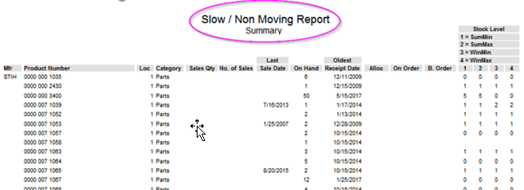
Keep Levels Up To Date

Slide 12


Knowledge Base Resources
Inventory Status Report
Defining Stok Levels
Setting Stock Levels
Changing Seasonal Stocking Levels

Slide 14
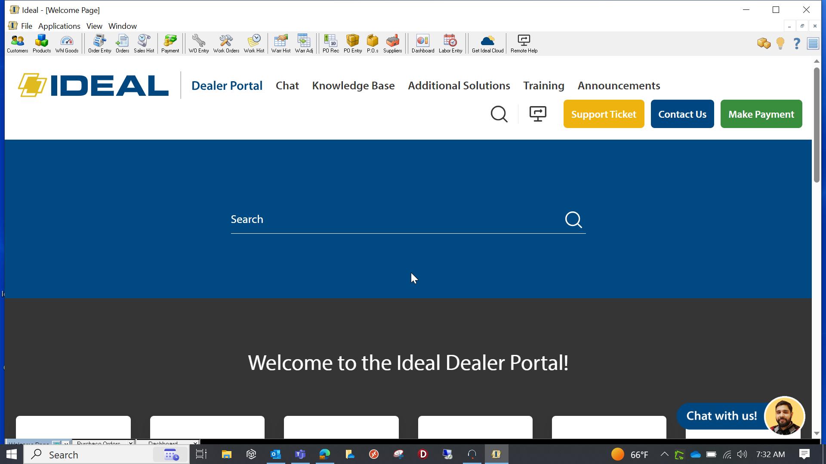
Additional Information

