Slide 1


Generating
Revenue
February 2025
Jim Daum, Implementation Specialist

Slide 2
Agenda
1.
Why Get Out Of Bed?
2.
Sales
3.
Parts
4.
Service

Slide 3

You Have To Get Up!

Slide 4
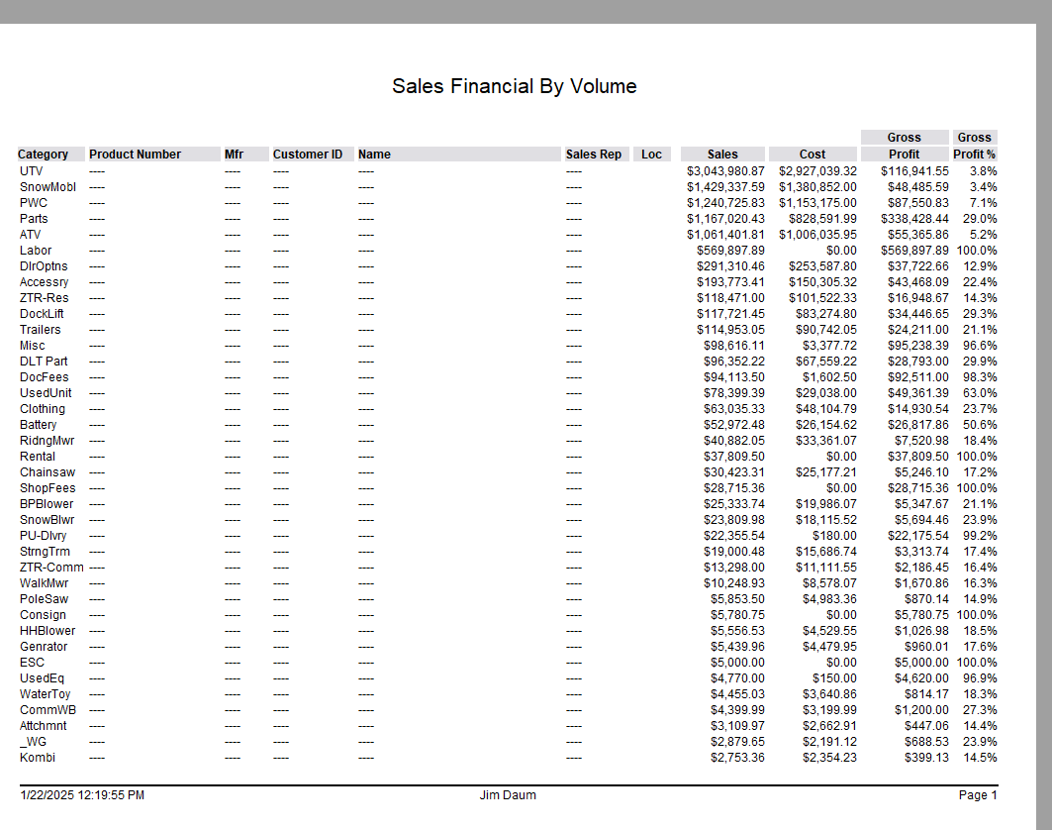

Do you know your $$$?

Slide 5
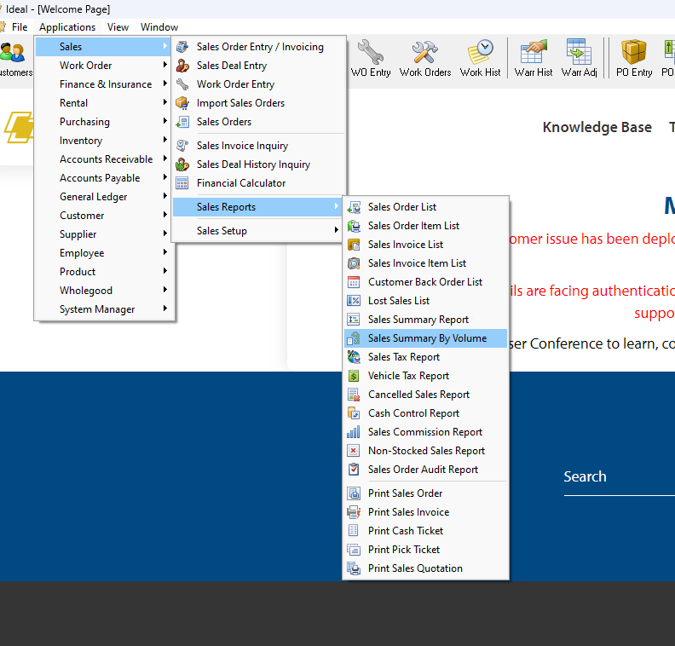
Sales Summary By Volume

Slide 6
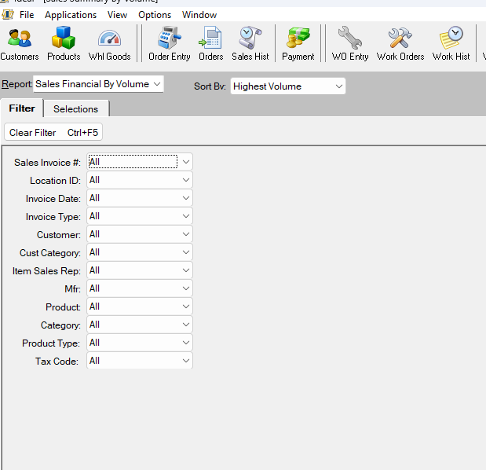
Sales Summary Filter

Slide 7
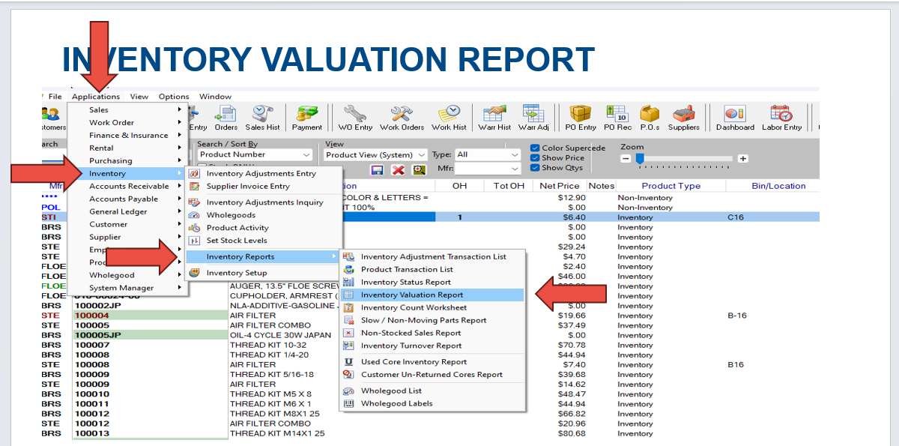
Inventory Valuation Report

Slide 8
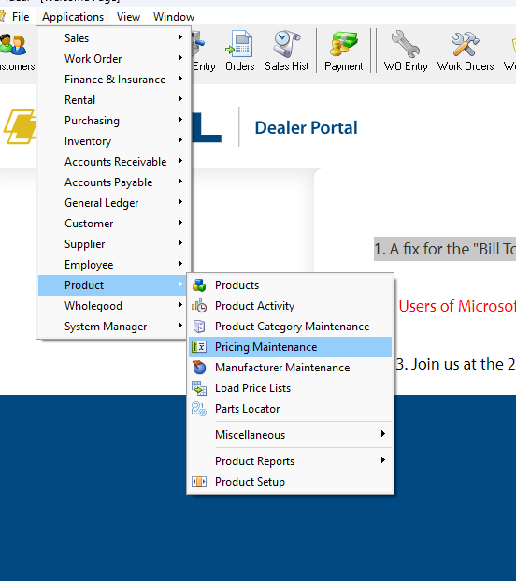
Product Pricing Maintenance Parts Matrix / Range

Slide 9
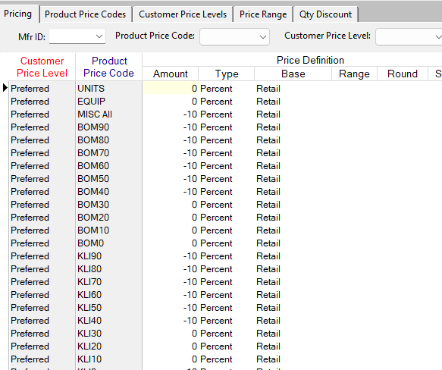
Setting Matrix / Range

Slide 10
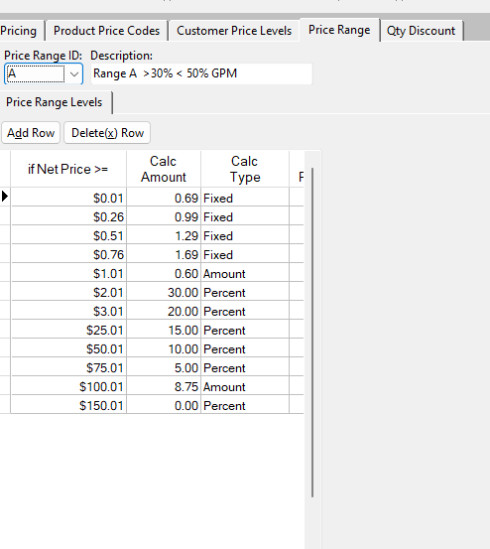
Price Range / Matrix

Slide 11
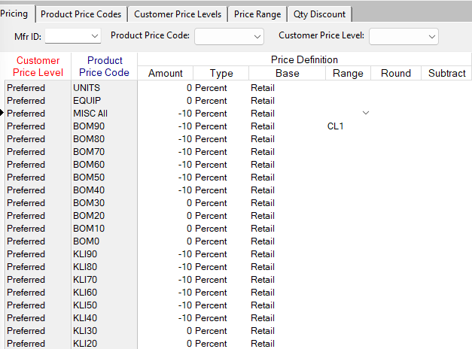
Setting Range / Matrix

Slide 12
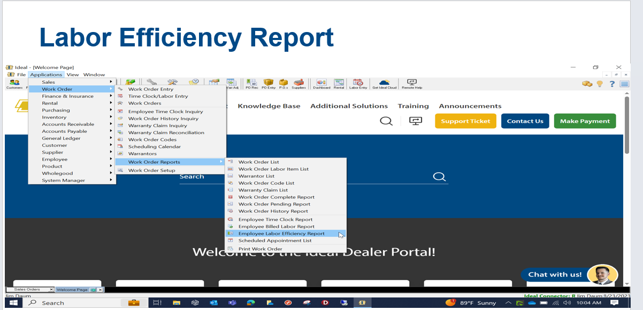
Labor Efficiency Report

Slide 13
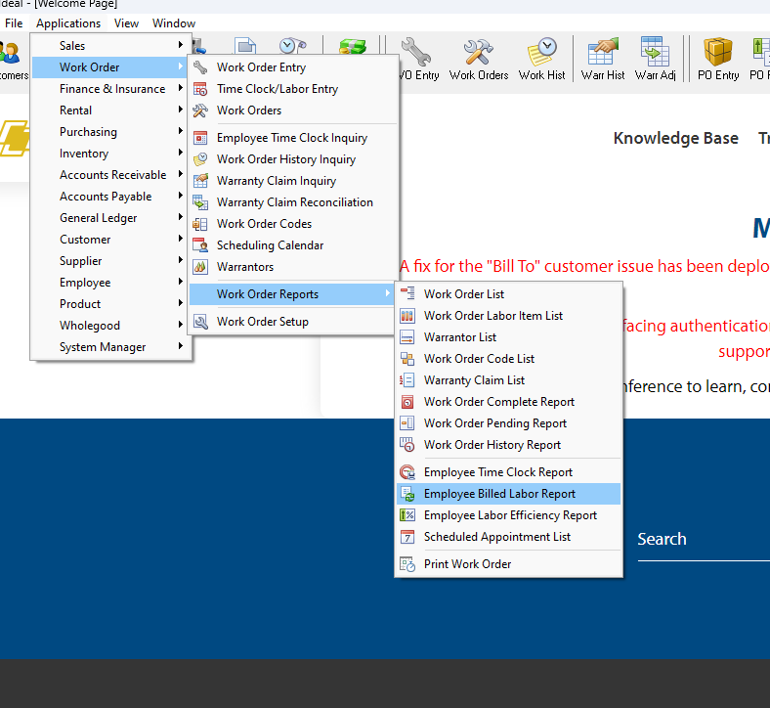
Billed Labor Report

Slide 14


Knowledge Base Resources
Sales Summary Report Overview
Finding Your Top Selling Products
Pricing Maintenance
Five Steps to Improve Efficiency
Running the Employee Labor Efficiency Report

Slide 16
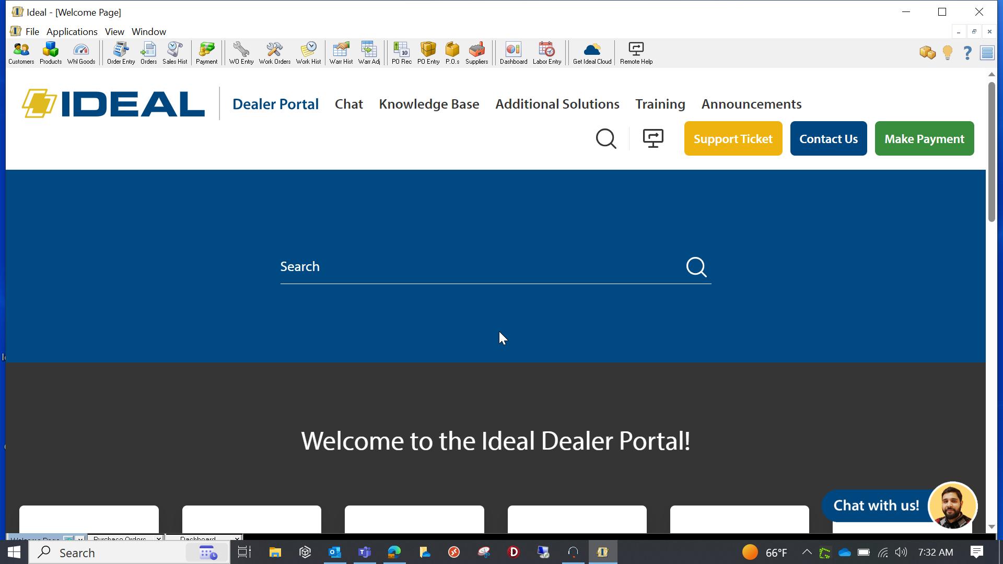
Additional Information

