Slide 1
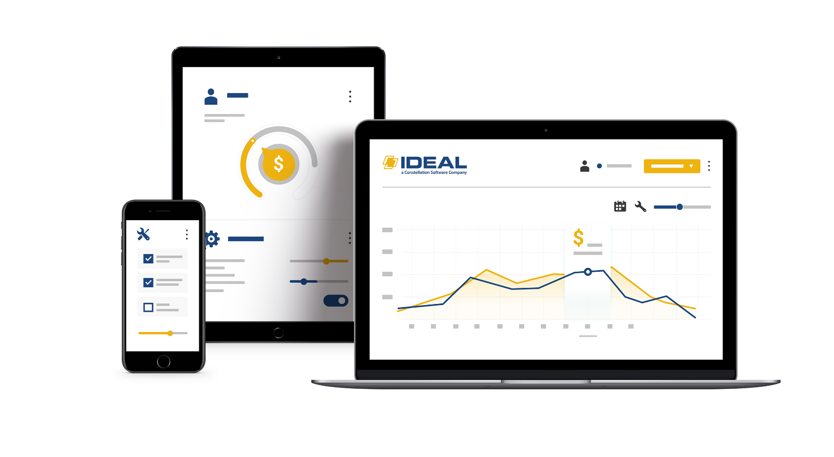


2025 User Conference
Learn & Grow at our User Conference
in Jacksonville!
February 10 - 12th, 2025
Jacksonville, FL

Slide 2
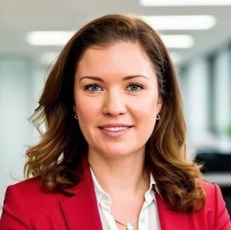
Kseniya Savelyeva
VP of Operations, Ideal & c-Systems

Slide 3
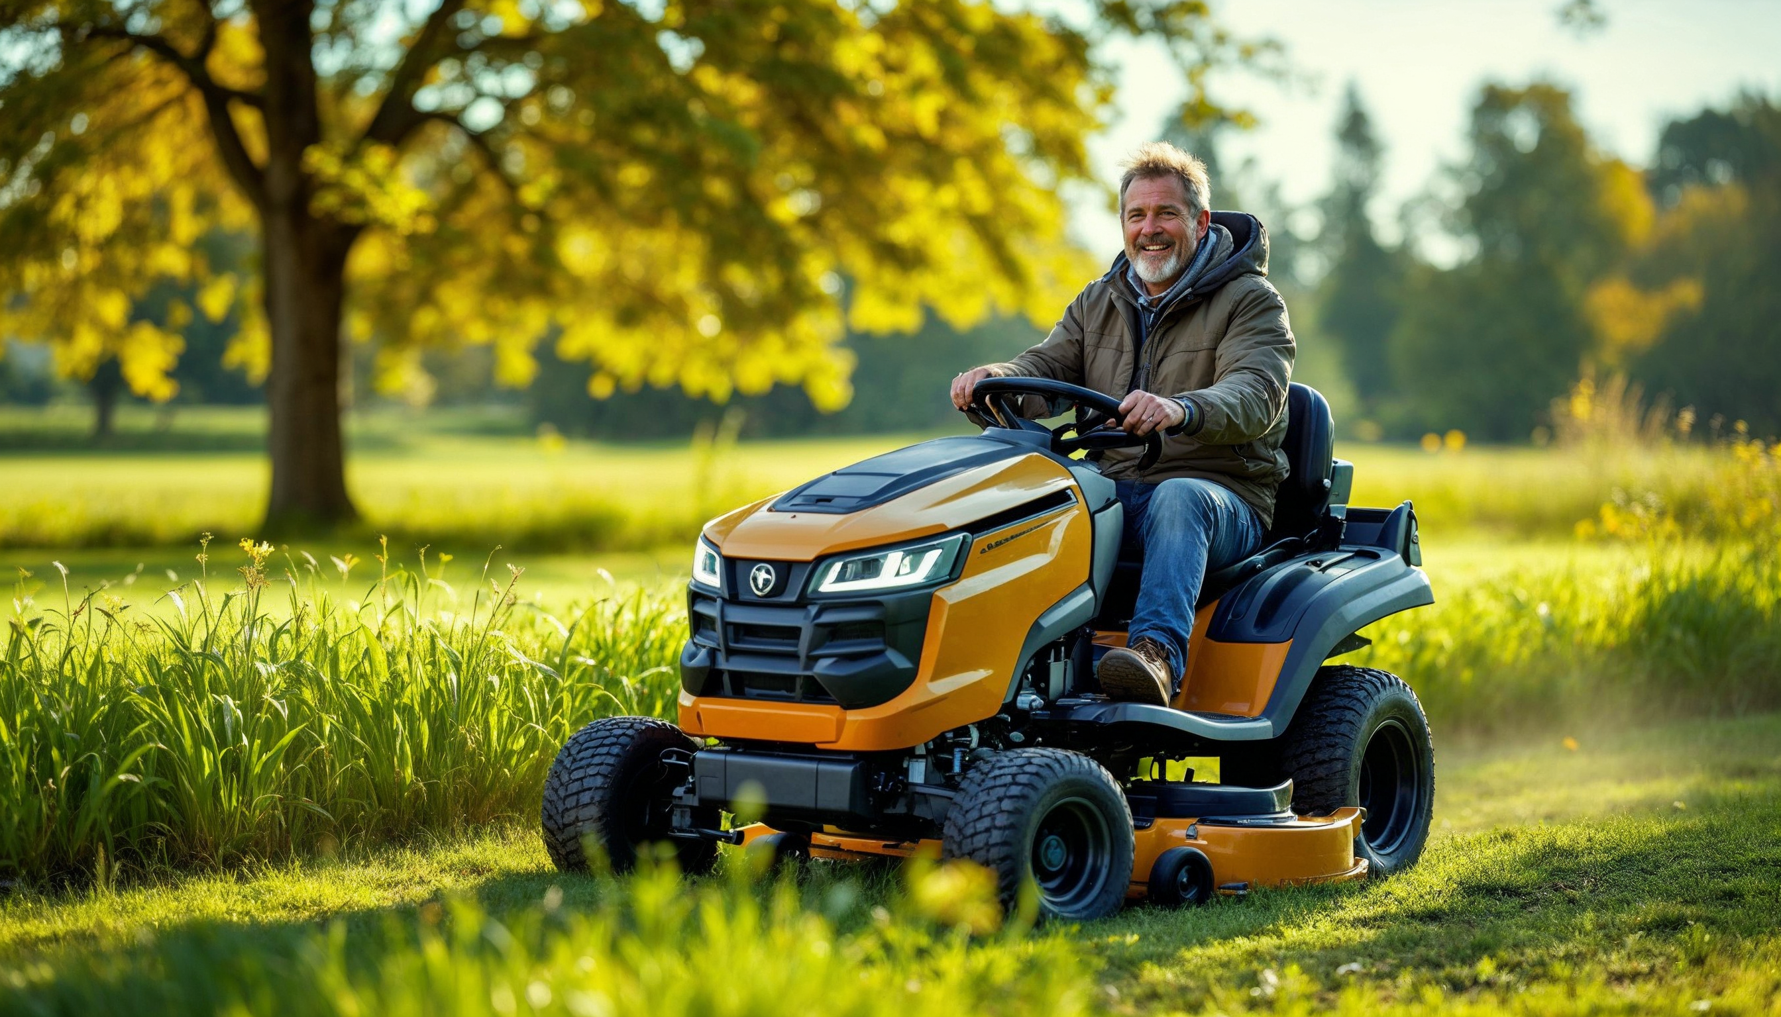
Over 2,000 OPE+ dealers

Slide 4
































Welcome!

Slide 5
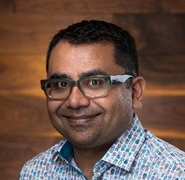
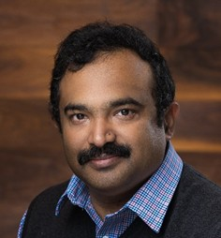
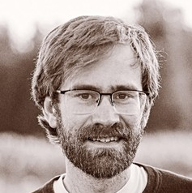
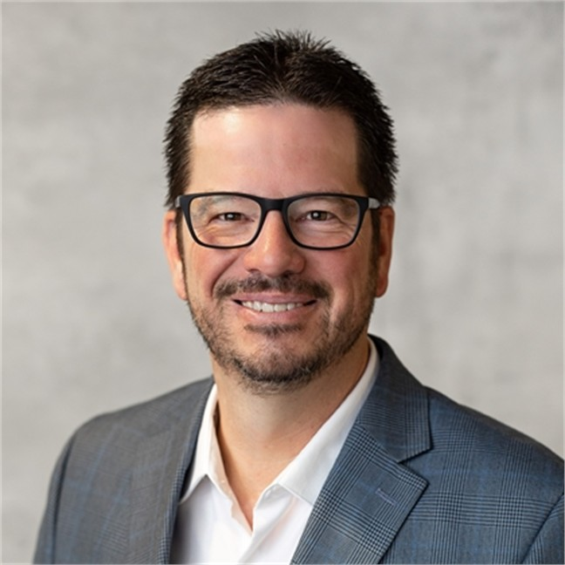
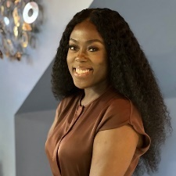
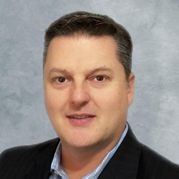
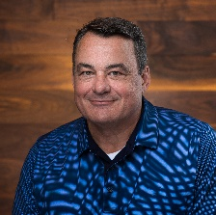
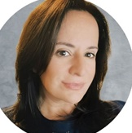
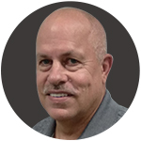
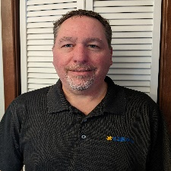
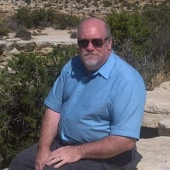
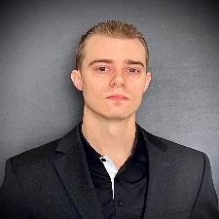
Ideal Team
Ajay Thakur
General Manager
Muthu Kannan
Product
Josiah Mahon
Product
Curt Mendel
Sales Manager
Gifty Afrifa
Account Manager
Jason Wilson
Account Manager
David Dismuke
Sales Director
Katie Mitchell
Trainer
Jim Daum
Trainer
Jeff Plecity
Trainer
Dave Baumgarten
Trainer
Ross Morgan
Cloud

Slide 6
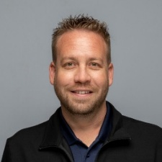
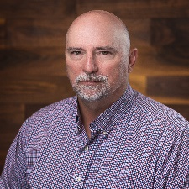
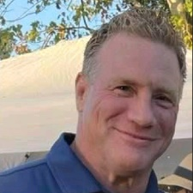
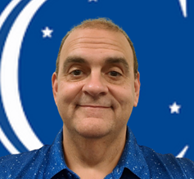

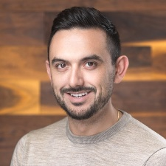
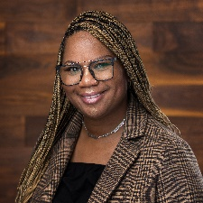
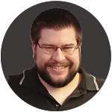
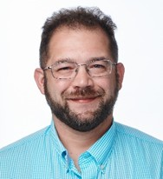
Target Team
Driving Innovation
TargetCRM
TargetLoyalty
TargetWeb
Tim Berman
Product
Brian Kristiansen
TargetPay
Gene Lydick
TargetPay
Kevin Koziol
TargetWeb
Daniel Palumbo
TargetCRM
Lydia Jenkins
TargetCRM
Ben Schmidt
TargetCRM
Justin Stacey
TargetCRM
TargetService
TargetPay
TargetPOS

Slide 7


Agenda
Monday:
1:00 AM – 4:30 PM – Training Sessions (Ideal / TargetApps)
4:30 AM – 6:00 PM – Networking Reception
Tuesday:
8:00 AM – 8:45 AM – Breakfast Masterclass: Digital Retailing
9:00 AM – 9:45 AM – Exploring the Future of Ideal
10:00 AM – 5:15 PM – Training Sessions (Ideal / TargetApps)
Download presentations!
Wednesday:
8:00 AM – 8:45 AM – Breakfast Masterclass: E-Commerce Essentials
9:00 AM – 12:45 PM – Training Sessions (Ideal / TargetApps)

Slide 8
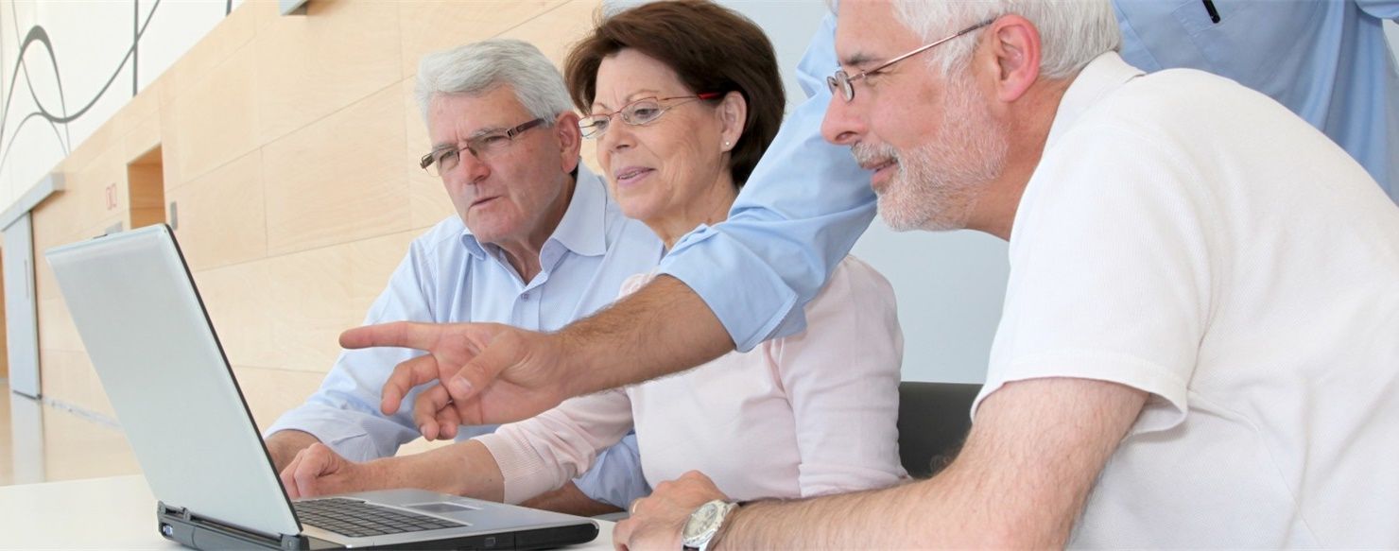
Drop by the LAB
Mon/Tue: 8am – 5pm
Wed: 8am – 2:30pm
Registration required

Slide 9




Help our OPE community grow!
Facebook Review
10 minutes = $100
Google Review
2-minute video testimonial

Slide 10
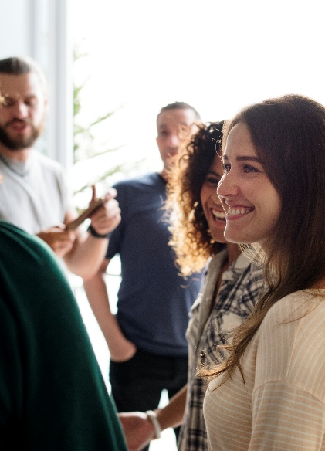





2025 User Conference
Network
Learn
Have fun!

